Slide 1
Final Year Project 2017-2018 Group 31 Review 2
Brain
Computer
Interface

Slide 2
SSVEP Classification
Prashanth H C
1PE14EC099
Pavan Kumar D
1PE14EC094
Sawan Singh Mahara
1PE14EC128
Lakshmiraj
1PE14EC412
Guide: Mrs. Vidya T V
Assistant Professor, PESIT-BSC

Slide 3
THE OBJECTIVE Classify EEG signals in an SSVEP using a statistical approach
SSVEP classification
Statistical Approach
Using our own data set
Explore a Riemann manifold approach
What is it?
Why is it better than the conventional CCA?
Benefits
Minimised search so faster detection possible theoretically.
Covariance estimation and distance metric dependencies.
Fine tuning possible
Double edged sword, however

Slide 4
Offline SSVEP Classification
EEG Digital Database
Digital Filter
Data Matrix
Classifier Algorithm
Class Prediction

Slide 5
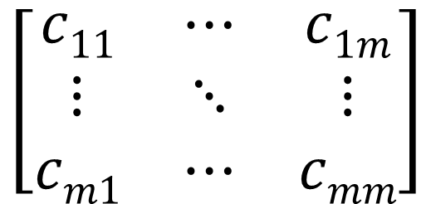
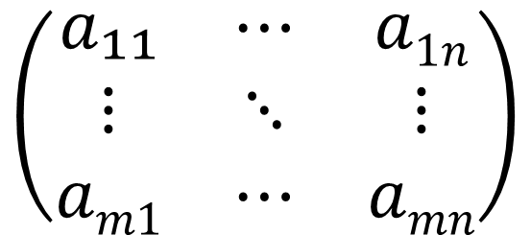
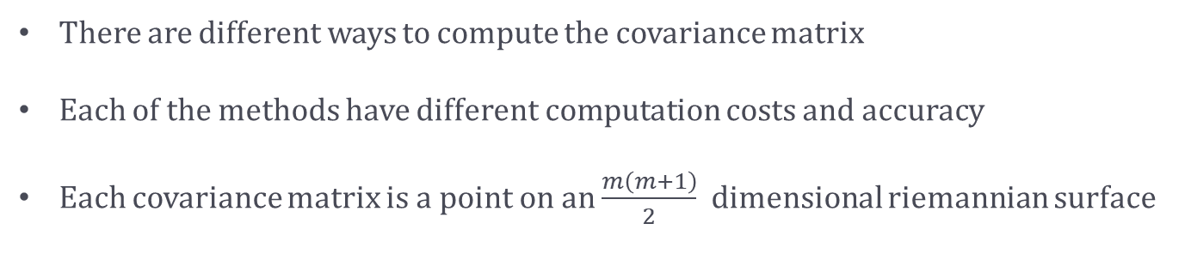
The Data
$$\left(\begin{matrix}a₁₁ & ⋯ & a1n \\ ⋮ & ⋱ & ⋮ \\ am1 & ⋯ & amn\end{matrix}\right)$$
$$\left[\begin{matrix}c11 & ⋯ & c1m \\ ⋮ & ⋱ & ⋮ \\ cm1 & ⋯ & cmm\end{matrix}\right]$$
EEG Data
Covariance Matrix
There are different ways to compute the covariance matrix
Each of the methods have different computation costs and accuracy
Each covariance matrix is a point on an $\frac{m\left(m+1\right)}{2}$ dimensional riemannian surface

Slide 6
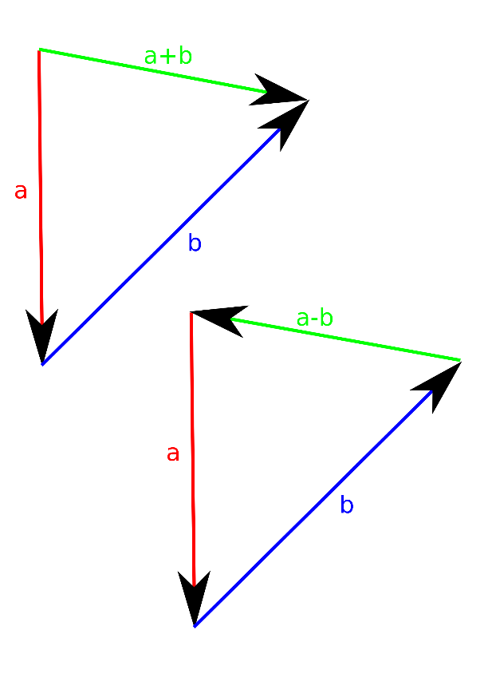
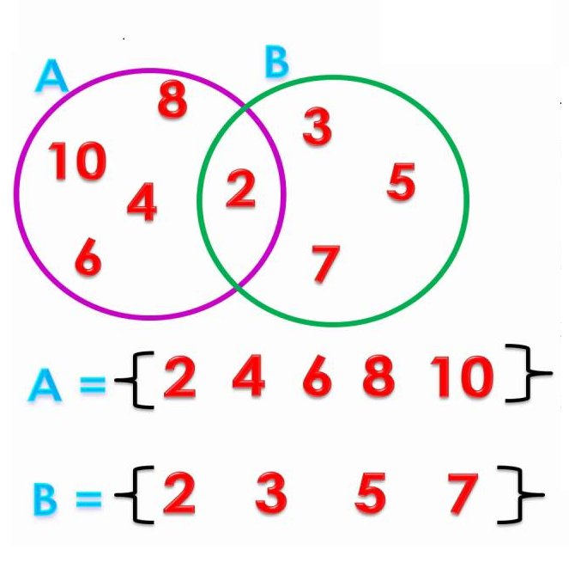
What is a vector?

Slide 7
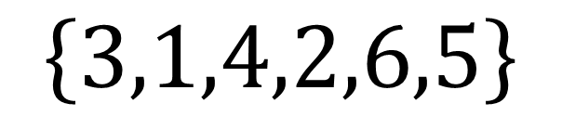

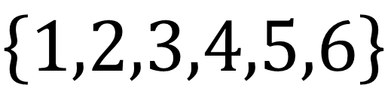

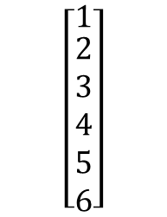

Ordered Set
$$\left\{1,2,3,4,5,6\right\}$$
$$\left\{3,1,4,2,6,5\right\}$$
$$Different From$$
$$\left[\begin{matrix}1 \\ \begin{aligned}2 \\ 3 \\ 4 \\ 5 \\ 6\end{aligned}\end{matrix}\right]$$
$$\left[\begin{matrix}3 \\ \begin{aligned}1 \\ 4 \\ 2 \\ 6 \\ 5\end{aligned}\end{matrix}\right]$$
$$Different From$$

Slide 8
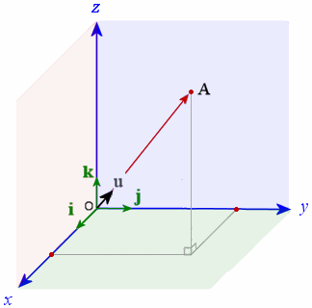
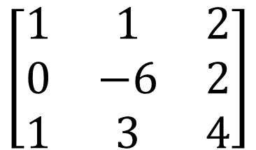
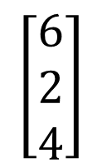

Geometric Representation
$$\left[\begin{matrix}1 & 1 & 2 \\ 0 & −6 & 2 \\ 1 & 3 & 4\end{matrix}\right]$$
$$[2 6 4]$$
$$\left[\begin{matrix}\begin{aligned}6 \\ 2 \\ 4\end{aligned}\end{matrix}\right]$$

Slide 11

$$The Original ′Vector′$$

Slide 12





What is Distance?
$$Between vectors x and y$$
$$\sqrt{\sum_{i=1}^{n}{{\left(x_{i}−y_{i}\right)}^{2}}}$$
$Euclidean Distance$
Manhattan Distance
Mean Squared Distance
$$\sum_{i=1}^{n}{\left|x_{i}−y_{i}\right|}$$
$$\frac{1}{n}\sum_{i=1}^{n}{{\left(x_{i}−y_{i}\right)}^{2}}$$

Slide 13



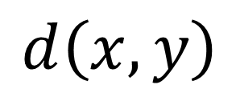


Conditions For a Distance Measure
$$ⅆ\left(x,y\right)$$
$$For any Distance function$$
$ⅆ\left(x,y\right)≥0$
$ⅆ\left(x,y\right)=0⇔x=y$
$ⅆ\left(x,y\right)=ⅆ\left(y,x\right)$
$ⅆ\left(x,z\right)≤ⅆ\left(x,y\right)+ⅆ\left(y,z\right)$

Slide 14

$$The ′Centroid^{′}$$
or
Mean Covariance Matrix

Slide 15
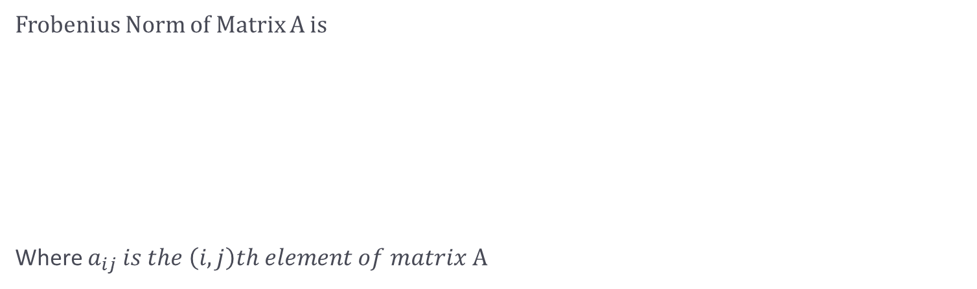



The Riemannian Distance
$${\left\|\ln\left(C_{1}^{−1}C_{2}\right)\right\|}_{F}$$
Frobenius Norm of Matrix A is
Where $a_{ij}$ $is the \left(i,j\right)th element of matrix$A
$$\sqrt{\sum_{i=1,j=1}^{m,n}{a_{ij}^{2}}}$$
${\left\|A\right\|}_{F}$ $≜$

Slide 16
Centroid Means

Slide 17
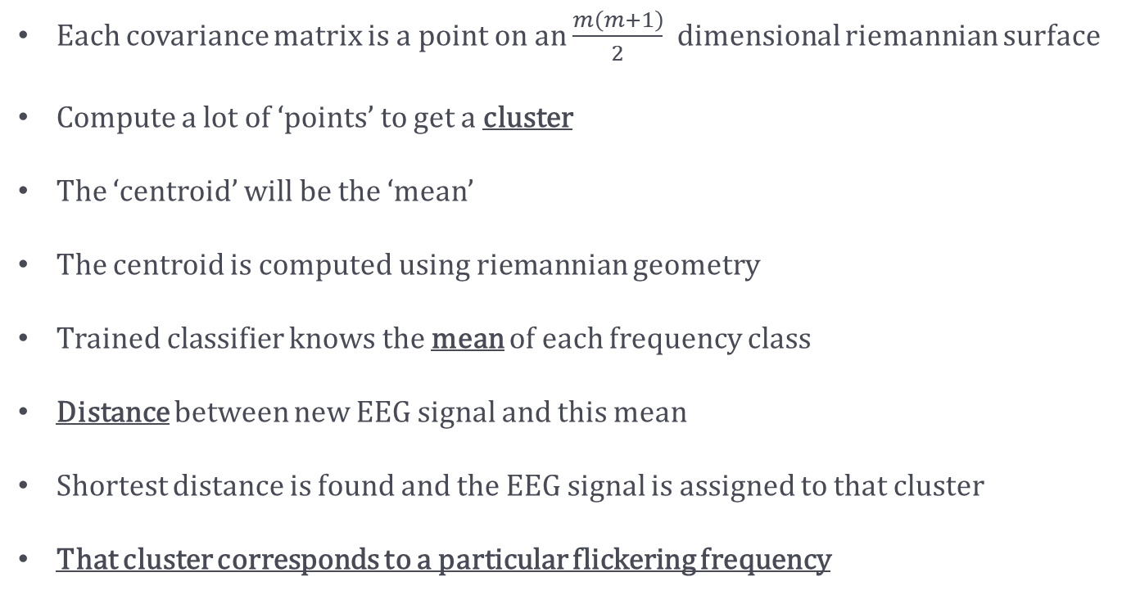
The Point of This All
Each covariance matrix is a point on an $\frac{m\left(m+1\right)}{2}$ dimensional riemannian surface
Compute a lot of ‘points’ to get a cluster
The ‘centroid’ will be the ‘mean’
The centroid is computed using riemannian geometry
Trained classifier knows the mean of each frequency class
Distance between new EEG signal and this mean
Shortest distance is found and the EEG signal is assigned to that cluster
That cluster corresponds to a particular flickering frequency

Slide 18
The Hardware
Cyton Board

Slide 19
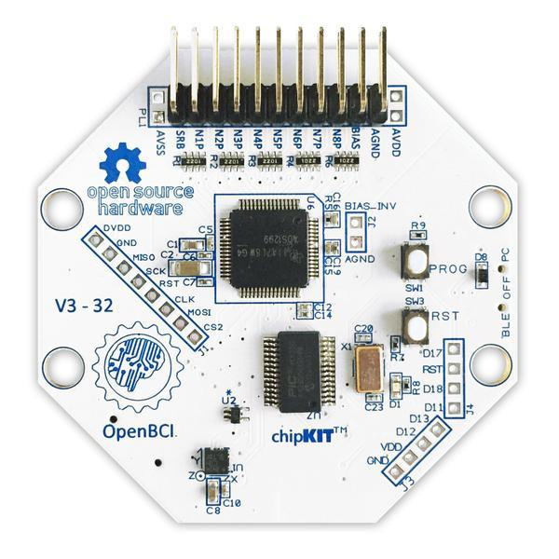
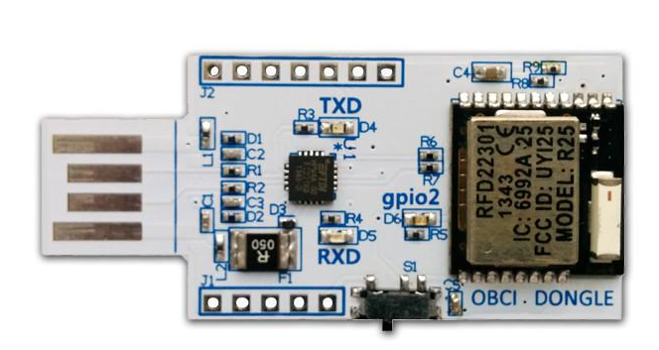
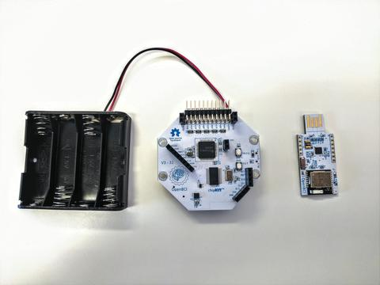
The Cyton
Spec Sheet
Compatible with active and passive electrodes
8 differential, high gain, low noise input channels
Texas Instruments ADS1299 ADC
PIC32MX250F128B microcontroller
RFduino Low Power Bluetooth radio
24-bit channel data resolution
Programmable gain: 1, 2, 4, 6, 8, 12, 24
3.3V digital operating voltage
+/-2.5V analog operating voltage
~3.3-12V input voltage
LIS3DH accelerometer
Micro SD card slot
5 GPIO pins, 3 of which can be Analog
The Dongle
Spec Sheet
• RFD22301 radio module from Rfdigital
• FT231X USB-to-serial converter from FTDI
• Can upload code to the OpenBCI board or the dongle
• Fully broken out and pin-compatible RFduino form factor

Slide 20
The Gantt Chart

Slide 21
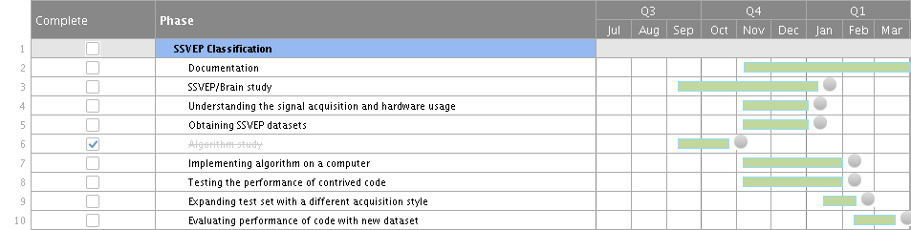

Slide 22
Thank You

